Slide 1
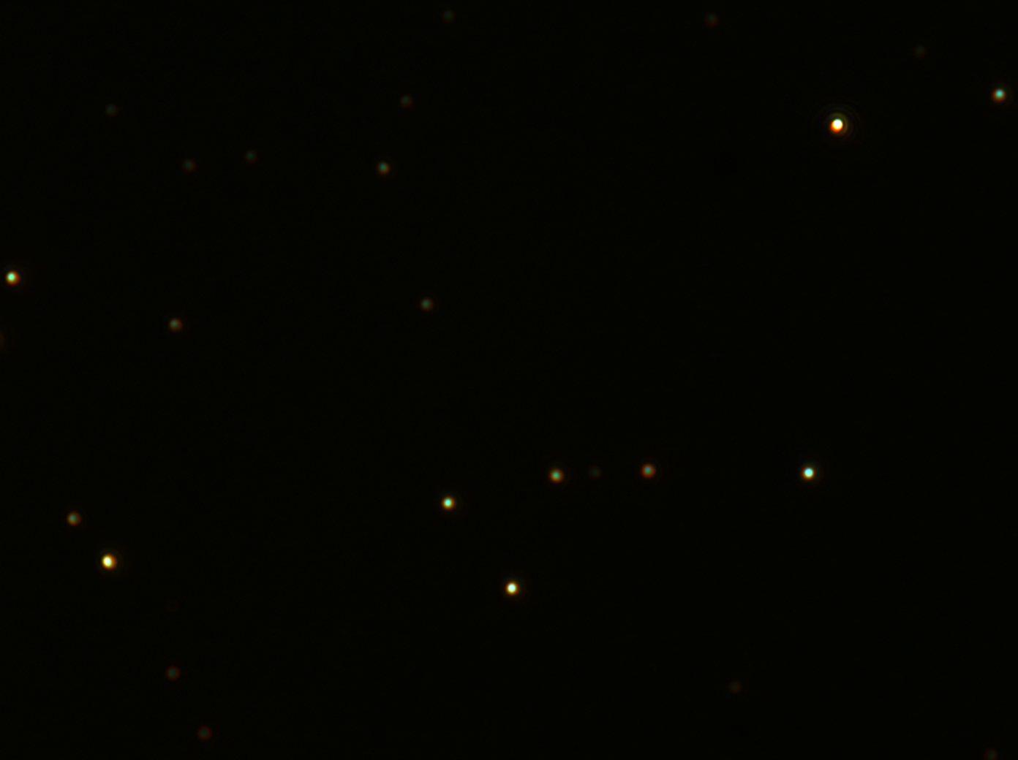
b
500 nm
c
d
b
e
f
f
d
c
e

Slide 2
500 nm

Slide 3
